Slide 1
PALMORIA-MANUFACTURING
Employee Analysis

Slide 2
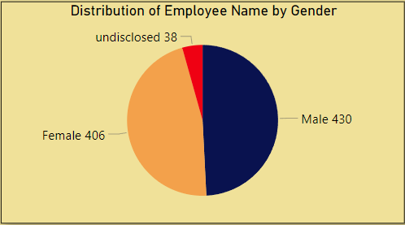
Distribution of Employee Name by Gender
The company employs a total of 874 individuals, comprising 430 males, 406 females, and 38 employees whose gender is not specified. The average salary for male employees is $75,000, while female employees earn an average of $73,000. Employees with unspecified gender have an average salary of $79,000. Among the top five highest-paid employees, the salary figures are as follows: Annipinse earns $119,670, Carmel Pancoust $119,550, Gamalied Ewins $119,660, Kai Ryder $119,930, and Triffani Mecozzi $119,750.

Slide 3
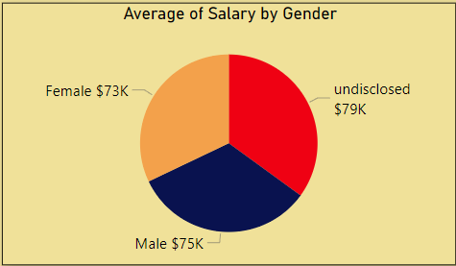
Average of Salary by Gender
The company employs a total of 874 individuals, comprising 430 males, 406 females, and 38 employees whose gender is not specified. The average salary for male employees is $75,000, while female employees earn an average of $73,000. Employees with unspecified gender have an average salary of $79,000.

Slide 4
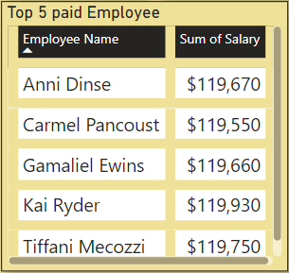
Top 5 paid Employee
Among the top five highest-paid employees, the salary figures are as follows: Annipinse earns $119,670, Carmel Pancoust $119,550, Gamalied Ewins $119,660, Kai Ryder $119,930, and Triffani Mecozzi $119,750.

Slide 5
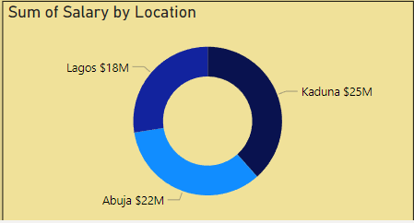
Sum of Salary by Location
Salaries are distributed across three locations: Abuja, Lagos, and Kaduna. Kaduna leads with the highest total salary expenditure, amounting to $25 million, followed by Abuja at $22 million and Lagos at $18 million. In terms of average salary, Lagos holds the highest average at $76,000, with Kaduna at $74,000, and Abuja at $72,000.

Slide 6
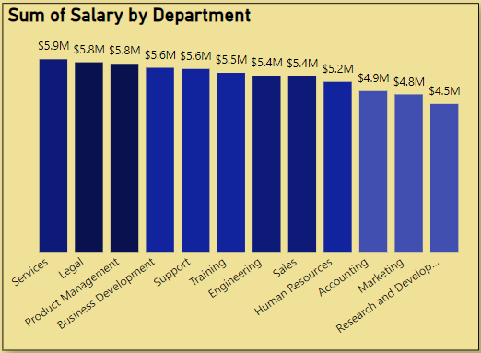
Sum of Salary by Department
The company comprises twelve departments, with the Service Department leading in terms of salary expenditure, disbursing $5.9 million. Following closely are the Legal and Product Management Departments, each allocating $5.8 million in salaries. The Business Development and Support Departments both report salary expenditures of $5.6 million. Other departments also exhibit strong salary payments. To gain a comprehensive understanding of the salary distribution across all departments, further analysis is recommended.

Slide 7
Thank You

